Slide 1
The IP Clinic (And What We Can Do For You!)
Professor Joe Barich

Slide 2
Today
Intro
Patent Basics
Trademark Basics
The IP (Intellectual Property) Clinic
Patent Track
Trademark Track
Working With The IP Clinic

Slide 3
About Joe Barich
University of Illinois ECE grad – 94 BS, 96 MS
More than 20 years as a Patent/Trademark Attorney
15 years at large Chicago IP-specialty firm
Founded Barich IP Law Group in 2013
2019-2024 Illinois SuperLawyer (top 5% of practicing attorneys) and 4 time Illinois Rising Star on the Super Lawyers list
Patent Buddy® List of Top Patent Prosecutors (top 2%) in the areas of "Computer, Electrical, Software, and Business Methods“
Prosecuted 1700+ patents, 500+ trademarks, and numerous copyrights in the US and internationally
Totally humble and never sarcastic ☺

Slide 4
Academics
Adjunct Professor, U. of Illinois College of Law
Taught Patent Prosecution since 2005
Founded IP Clinic in 2008
Lecturer - U of I College of Engineering
Engineering Law since 2010 (mostly undergrad)
TEC class! - Startups: Incorporation, Funding, Contracts, and IP since 2014 (great for entrepreneurs!)
Awards
Campus Award for Undergrad Teaching Excellence
Department Head Teaching Award x2
Alpha Pi Mu & Gamma Epsilon Excellence in Teaching Award
List of Teachers Ranked as Excellent/Outstanding
Guest Lecturer for Notre Dame Executive MBA on IP
Senior Lecturer, U. of Wisconsin, Masters of Engineering Management Program –
Taught Engineering Law since summer 2018

Slide 5
Intellectual Property (IP) Rights - 1
“Big 3”
Patents - (P)
Functionality
How something works
Copyrights - ©
Expression
What something looks like, sounds like, etc.
Trademarks – TM, ®
Origin of goods in trade
What company a product comes from
Can have (P), ©, and TM/® in same product
Many other IP rights

Slide 6
IP Rights - 2
Patents, Copyrights, and Trademarks operate very differently
Rules for one typically do not apply to the others
Term “IP” is a very loose grouping
Massive misunderstanding and confusion
Most businesses do not understand IP rights
Popular press often gets it wrong
But! Estimate of value of IP held by SP500 is in excess of $4 trillion
IP can be a powerful asset for a startup company

Slide 7
Patent Basics
Trademark Basics
The IP Clinic
Patent Track
Trademark Track
Working With The IP Clinic

Slide 8
What is a Patent?
Legal right to exclude others from practicing your invention
After March 15, 2013, patent is awarded to the first to file their patent application, not the first to invent
Excluded: Make, Use, Sell, Offer for Sale, or Import
Not a right for you to use, make, sell, etc.
Corollary: Getting your patent does not mean that your product is free from infringing the patent of another
Only examined for novelty, not infringement
Car + radio example

Slide 9
Novelty (PTO) ≠ Infringement (Sales)
Inventor #1
Inventor #2
CAR
+
RADIO
CAR
Patent #1
- Novelty-
Patent #2
Can’t sell a car with a radio in it without infringing Patent #2
Can’t sell a car with a radio in it without infringing Patent #1 (can’t sell ANY car without infringing Patent #1)
- Infringement-

Slide 10
What is a Patent Application? -1
Formal document filed with the Patent and Trademark Office (PTO) in an attempt to obtain a patent for an invention
Highly detailed and technical legal document
Typically about 40 pages long, includes drawings
Very easy for non-lawyers to make uncorrectable errors and lose their rights

Slide 11
What is a Patent Application? -2
Includes
Description/specification (your invention)
Claims (the legal protection that you want for your invention)
“A written description sufficient to enable one of ordinary skill in the art to practice the invention without undue experimentation and showing the inventor’s best mode.”

Slide 12
What is a Patent Application? -3
As soon as filed =“Patent Pending”
Someone who has filed a patent application with the PTO is said to be “prosecuting a patent” and the process is often called “patent prosecution.”

Slide 13
Warning! - BAR DATES!
U.S. has One Year Grace Period from date of first disclosure OR commercialization
Must file within the year or rights are permanently lost
Foreign = Often No Grace Period – disclose/ commercialize before filing and you blew it
Foreign rights can be preserved by filing an application in the U.S. before disclosure and then later filing foreign app claiming priority to U.S. app within one year
Disclosures in confidence (to attorney, under agreement of confidentiality), without commercialization, are typically OK

Slide 14
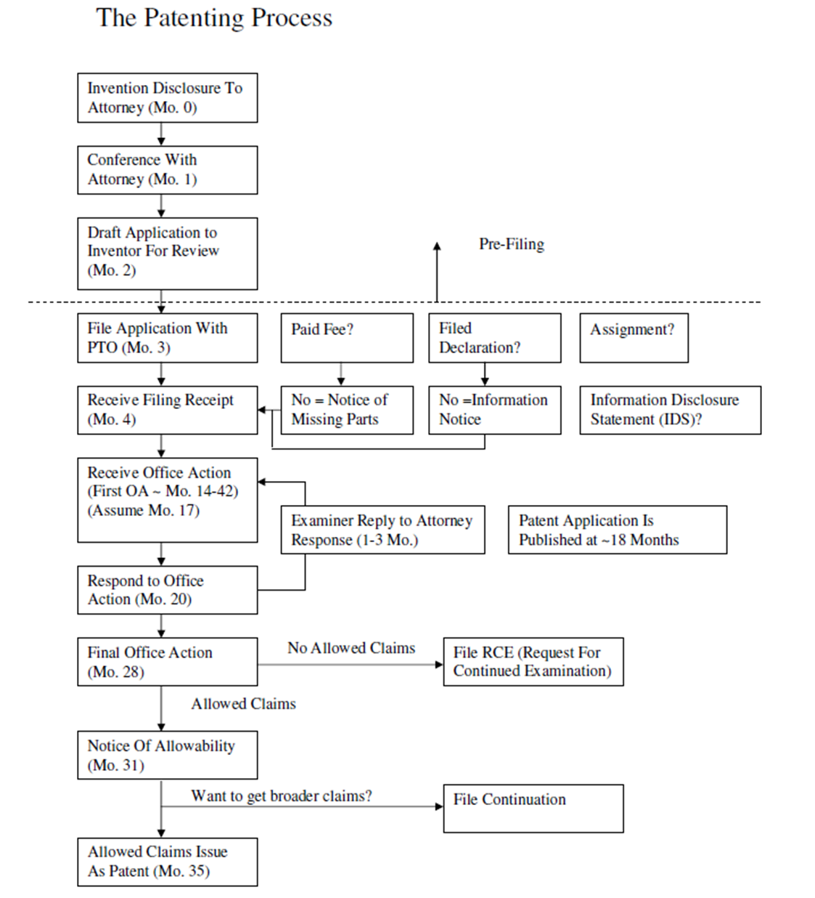

Slide 15
Requirements For Patentability
Statutory Subject Matter
35 U.S.C. § 101
An invention/machine/system, not just an idea
No abstract algorithms or principles of science
Novelty
35 U.S.C. § 102
No single Prior Art reference teaches all claim limitations
Non-Obviousness
35 U.S.C. § 103
Generally, the claim limitations are not found in 2 or more Prior Art references or in the knowledge of one of ordinary skill in the art

Slide 16
Sample Applications
U.S. Pat. App. No. 2012/0238319 “System and Method For Combined Alarm Detection and Emergency Signaling”
U.S. Pat. App. No. 2012/0010844 “Sensors, Systems, and Methods For Measuring Fluid Perturbation”
IP Clinic drafted patent applications
Available at www.joebarich.com/ip-clinic.html

Slide 17
What does a business do with a patent?
Enforceable from date of issuance to 20 years from effective filing or “priority” date
Often the primary asset of a start-up company
Most of the value of the company is in their IP
Can boost corporate valuation
Bar competitors from your market
#1 Use - Preserve your market share
Sue infringers for money/injunction
Use as leverage for a joint venture or tech swap

Slide 18
Patent Basics
Trademark Basics
The IP Clinic
Patent Track
Trademark Track
Working With The IP Clinic

Slide 19
What Is A Trademark?
An identifier that identifies the origin of goods or services in commerce
Typically a word or logo
Trademark lasts as long as it is used
Can last forever
Two Types of Trademarks
Unregistered, common-law trademarks - TM
Federally registered trademarks – ®
Infringement Standard– Consumer confusion
If a consumer would think that goods from a second company actually originated from the company owning the trademark, then there may be infringement

Slide 20
Common Law TM
Has some serious limitations
State law – not uniform nationwide
Limited in geographic area
Must have consumer association
Must prove actual damages
No registration process, so you can’t be sure that a court will enforce your TM
Tough to enforce on internet sales

Slide 21
Registered Trademarks
Must be registered with the Patent and Trademark Office (PTO)
Provides registration so you can be reasonably sure of your mark’s enforceability before suing
Federal law, not state law
Can file Intent-To-Use application
Only mark that can use ®
Geographic exclusivity is the entire US
Can use the same mark in different fields of goods without confusion
Can still last forever if used
Can get statutory damages – like registered ©
No longer need to prove actual damages

Slide 22
Registering A Trademark
File TM application with PTO
Word/Phrase or Logo Mark
One or more classes of goods – pay per class
Application goes to Examiner
Examiner searches mark
Office Action if rejected – typically due to potential consumer confusion with other registered marks
Otherwise, mark is allowed
Mark is published for opposition
Companies monitor new marks and file oppositions if they regard the new mark as too close to their own
If opposition, then lawsuit or abandon
Mark is registered on Principal Register
Mark can now be enforced

Slide 23
What does a business do with a TM?
TMs are used to identify your goods/company
You want to create a strong and identifiable brand for the consumer – and then be able to defend your brand
Once you start marketing, you don’t want to have to change your name
Cumulative effect of advertising
Can enforce against counterfeiters
Block them from market
Seize and destroy their goods
Sue for statutory damages
Enforceable forever if continually used

Slide 24
Patent Basics
Trademark Basics
The IP Clinic
Patent Track
Trademark Track
Working With The IP Clinic

Slide 25
What is the IP Clinic?
TEC/College of Law Joint Effort – 17th year!
We thank TEC for sponsorship!
Patent Track
You can get a Patent Application prepared for you!
But - Only if your company has an invention
Trademark Track
You can get advice with regard to trademark strategy and a Trademark application prepared for you!
All companies use trademarks
Both tracks – companies are independently chosen by law students
Want to make a meaningful contribution

Slide 26
IP Clinic Value (As of 2023)
63 patent applications
Typical cost $10,000-$12,000
Total = $630K - $756K
350+ trademark strategy and applications
Typical cost $2,000-$2,500
Total = $700K - $875K
Total value provided to University ecosystem by IP Clinic = $1,330,000-$1,631,000 (~$1.5 million)
This year ~$130,000 in value
4 patent applications
- 40 TM applications

Slide 27
Patent Basics
Trademark Basics
The IP Clinic
Patent Track
Trademark Track
Working With The IP Clinic

Slide 28
What is the Patent Track?
Law students draft patent applications for selected inventors for free
Inventors file drafted patent app themselves (we show how in a presentation) and pay fee
Inventors will have to obtain OTM (University Office of Technology Management) clearance before filing
Must sign OTM agreement
Must sign IP Clinic Agreement

Slide 29
Who writes the patent applications?
Law students in their 3L (final) year
Have taken Patent Law and Patent Prosecution and earned a B+ or better (tough professor – Me!)
Have already drafted at least one full patent application
Often have law firm experience
Will be expected to draft patent applications professionally in the fall, typically without additional instruction

Slide 30
Would the Law Students in the Patent Track please introduce themselves?

Slide 31
Patent Drawing Drafting
Nick Lenzen – Patent Drawing Draftsman
LenzenIP - lenzenip.com
Will draft formal patent drawings for all patent applications drafted by the IP Clinic
PTO typically requires drawings to be formalized before issuance of the patent, and it usually costs about $500-$1,000
Now, your patent can look professional even at filing – and filed drawings typically become published drawings
An additional benefit to your company

Slide 32
Patent Basics
Trademark Basics
The IP Clinic
Patent Track
Trademark Track
Working With The IP Clinic

Slide 33
What is the Trademark Track?
Law students assist companies in choosing their trademark and prepare a trademark application for free
Companies file prepared trademark applications themselves (we show how) and pay fee
No need for OTM permission
Must still sign IP Clinic Agreement

Slide 34
Trademark Track Work
Entrepreneurs erroneously think trademark searching is a straightforward text search
It’s not enough that your exact proposed mark is not in use
Trademarks are NOT like a domain name registry
PTO can reject your mark based on the legal principles of consumer confusion and/or descriptiveness
Law students provide insight into your odds of success and can research alternative marks
Check corporate name or name of product
Check corporate state registry (available?)
Check domain name availability (available?)

Slide 35
Who prepares the TM apps?
Law students in their 2L or 3L years
Background in Trademark Law
Often have law firm experience or will be working at a law firm in a few months
Often will be expected to prepare trademark applications professionally in the summer or after graduation, typically without additional instruction
Using a lawyer greatly increases your odds
2013 study – 83% chance of success with lawyer, 46% greater than without a lawyer

Slide 36
Would the Law Students in the Trademark Track please introduce themselves?

Slide 37
Patent Basics
Trademark Basics
The IP Clinic
Patent Track
Trademark Track
Working With The IP Clinic

Slide 38
IP Clinic - Patent Track
Inventor (for example, Cozad participant) has an innovation (or may not be sure they have an innovation)
Agrees to participate in IP Clinic – Indicate agreement on TEC form
Turns over business plan/description of innovation to the IP Clinic for evaluation
The more detailed the better
All disclosures to IP Clinic are in confidence

Slide 39
Patent Track -2
IP Clinic performs novelty search
Search 11+ million issued patents and other references
Searches are for internal IP Clinic use only
Law students rank and select innovations (one each) to be drafted as patent applications
We will have more inventions than law students, so what can you do to increase your odds?
Better disclosure
Be farther along the development chain – Funding? Incorporated? Grants? Website already set up?
Be readily available

Slide 40
Patent Track -3
IP Clinic contacts inventor to obtain additional information and signed OTM and IP Clinic forms
IP Clinic works with inventor to draft patent application
IP Clinic interviews inventor and collects needed documents/figures
Inventor must be available and help out!
IP Clinic Drafts patent application
Law students draft – Prof. Barich reviews

Slide 41
Patent Track -4
Completed Patent Application given to both inventor and OTM
Inventor MUST receive clearance letter from OTM before filing
Advise OTM if timing is an issue
Inventor files in their own name
Presentation on how to file your Patent/TM application with the PTO
Fri, April 26, 1pm, Law School Room F
See www.joebarich.com/ip-clinic.html
PTO fee – as low as $364 for Micro Entity

Slide 42
Trademark Track -1
All companies have brands/marks/corporate or product names that they can use trademark information with regard to
Company agrees to participate in IP Clinic and signs IP Clinic Participation and Consent Form
Each law student is assigned 5 companies to assist
We will service as many companies as we can

Slide 43
Trademark Track -2
Law students meet with companies to discuss their current marks and strategy
Search their names/marks and discuss results with companies
Help formulate trademark procurement strategy
NOT trademark clearance/non-infringement guarantee
Select at least one mark per company and prepare a federal trademark application
Prof Barich reviews applications
Again, companies MUST make themselves available and work with the law student or they may be dropped from the clinic

Slide 44
Trademark Track -3
No need to work out rights with OTM
Company files TM in their own name
Presentation on how to file your trademark application with the PTO (same as patent presentation)
Fri, April 26, 1pm, Law School Room F
See www.joebarich.com/ip-clinic.html
PTO fee – could be as low as $250, likely $350

Slide 45
IP Clinic Participation and Consent Form
Good law students - not legal experts
No guarantees
The PTO may not allow your patent or trademark
We are only writing the application
We don’t consider patent or trademark infringement, just novelty/registrability
No guarantees that your mark will be free from infringing another’s mark
Our client is the University, not you
You won’t put us or our firms out of business by asserting a conflict of interest
You won’t sue the U of I
See Form for details and/or consult a lawyer

Slide 46
OTM/IP Clinic Agreement
Patent Track Only
Only OTM (Not IP Clinic) can make rights determination for the University
Participation in IP Clinic does not impact rights
If OTM asserts rights, standard revenue sharing terms apply
Copies of completed application are given to both inventor and OTM
INVENTORS MUST CLEAR RIGHTS WITH OTM ON THEIR OWN BEFORE FILING

Slide 47
Why be in the IP Clinic?
Patent or Trademark Application = respect & value for your venture
Preference to serious entrepreneurs
Learn about patents and trademarks
Maybe get your own patent or TM
Seriously, how cool is that!
Business plan “Intellectual Property” section?
“Patent Pending” looks good on a resume
Not required to actually file the patent or trademark application, but we prefer to work with people who are more serious
See www.joebarich.com/ip-clinic.html for more info

Slide 48
Questions?
Thank You!
Joe Barich
Academic Website: JoeBarich.com
Professional Website: BarichIP.com
Barich IP Law Group
312-620-2471
joebarich@barichip.com

