Slide 1
Locking Out Lock Collar Issues
Using GE 400 Material in Industry

Slide 2
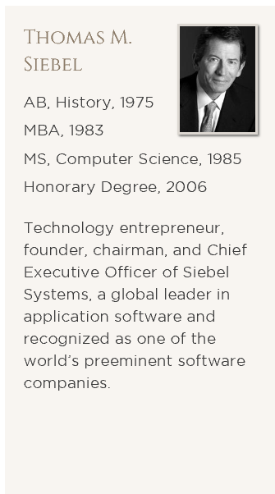

Slide 4
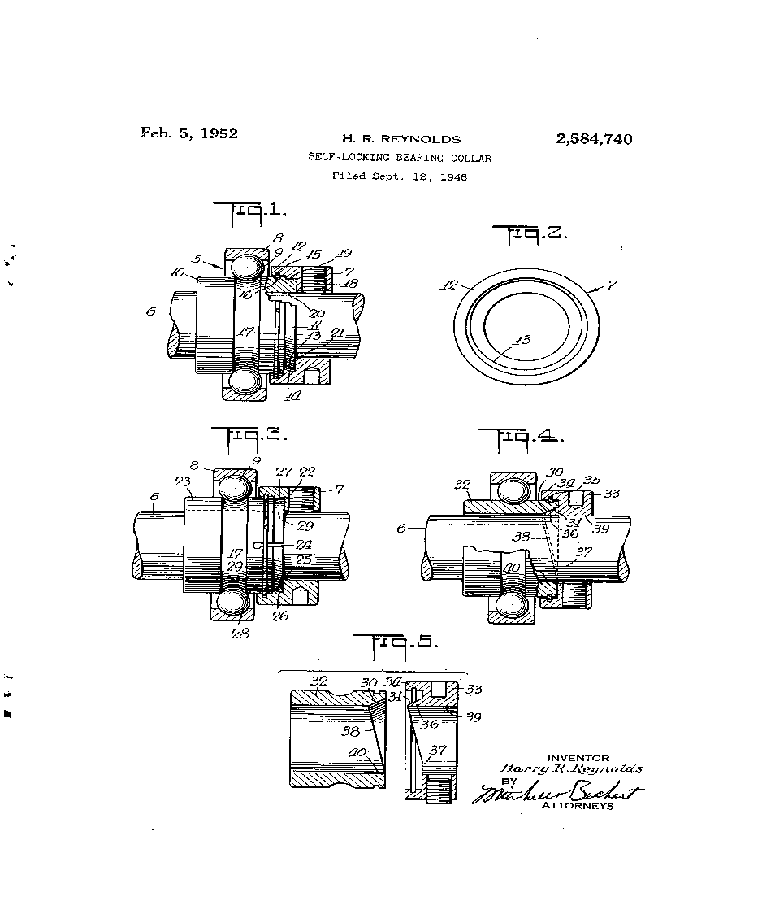
The Lock Collar
Used in applications where a shaft rotates in a singular direction
Locks bearing to shaft by rotating offset circle on collar against offset race of bearing

Slide 5
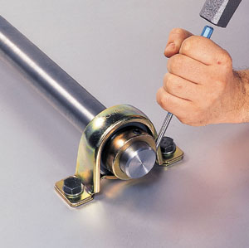
The Problem
Inconsistency in installation
Customer found issue leading to significant warranty claims
Safety and ergonomics
Previous intervention unsuccessful

Slide 6
Innovating
Business case and failure modes identified
Parallel design routes identified and prototyped
Prototypes small scale tested in assembly lab
Technology acknowledged to international partners
Larger scale tested on line
Technology marketed and supported for global application
Over the course of development, I took a systems engineering route. Innovation occurred for the product technology, the business case, and the presentation to the company.

Slide 7
The Solution
Elimination of hammer and drift
Safety
Unidirectional installation
Mistake Proofing
Elimination of safety and warranty claims
Reduction of company cost
Single installation process for parts
Standardized Process for global intervention

Slide 8
Intellectual Property in Industry
Bridging the legal gap
Implementation
Technology Innovation

Slide 9
Recognition
In the summer of 2014 the lock collar project was recognized as the strongest contribution to safety and ergonomics improvement in the John Deere global enterprise.
2015 finalist for the Illinois Innovation Prize

Slide 10
Lasting Lessons
Don’t worry so much if you don’t have everything figured out yet
Stop comparing to others – Things always look easier from the outside
Take Risks… Don’t let failure consume you
Always make sure you know where your suit pants are the night before a photo shoot

