Slide 1
Basics of Patents and Trademarks – and the IP Clinic
Professor Joe Barich

Slide 2
Today
Who is Joe Barich?
Patent Basics
Trademark Basics
The IP (Intellectual Property) Clinic
Patent Track
Trademark Track
Working With The IP Clinic

Slide 3
About Joe Barich
University of Illinois ECE grad – 94 BS, 96 MS
More than 20 years as a Patent/Trademark Attorney
15 years at large Chicago IP-specialty firm
Founded Barich IP Law Group in 2013
2019-22 Illinois SuperLawyer (top 5% of practicing attorneys) and 4 time Illinois Rising Star on the Super Lawyers list
Patent Buddy® List of Top Patent Prosecutors (top 2%) in the areas of "Computer, Electrical, Software, and Business Methods“
Prosecuted 1700+ patents, 500+ trademarks, and numerous copyrights in the US and internationally
Totally humble and never sarcastic ☺

Slide 4
Academics
Adjunct Professor, U. of Illinois College of Law
Taught Patent Prosecution since 2005
Founded IP Clinic in 2008 – Patents and Trademarks for you!
Lecturer - U of I College of Engineering
Engineering Law since 2010
TEC class! - Startups: Incorporation, Funding, Contracts, and Intellectual Property since 2014
Awards
List of Teachers Ranked as Excellent/Outstanding (95%+)
Alpha Pi Mu & Gamma Epsilon Excellence in Teaching Award
Department Head Teaching Award (Twice!)
Campus Award for Excellence in Undergraduate Teaching
Guest Lecturer for Notre Dame Executive MBA on IP
Senior Lecturer, U. of Wisconsin, Masters of Engineering Management Program –
Teach Engineering Law to practicing engineers since 2018

Slide 5
Intellectual Property (IP) Rights - 1
“Big 3”
Patents - (P)
Functionality
How something works
Copyrights - ©
Expression
What something looks like, sounds like, etc.
Trademarks – TM, ®
Origin of goods in trade
What company a product comes from
Can have (P), ©, and TM/® in same product
Many other IP rights

Slide 6
IP Rights - 2
Patents, Copyrights, and Trademarks operate very differently
Rules for one typically do not apply to the others
Term “IP” is a very loose grouping
Massive misunderstanding and confusion
Most businesses do not understand IP rights
Popular press often gets it wrong
But! Estimate of value of IP held by SP500 is in excess of $4 trillion
IP can be a powerful asset for a startup company
But is often not recognized or managed correctly

Slide 7
Patent Basics
Trademark Basics
The IP Clinic
Patent Track
Trademark Track
Working With The IP Clinic

Slide 8
What is a Patent?
Legal right to exclude others from practicing your invention
Excluded: Make, Use, Sell, Offer for Sale, or Import
Not a right for you to use, make, or sell
Corollary: Getting your patent does not mean that your product is free from infringing the patent of another
Only examined for novelty, not infringement
Car + radio example
After March 15, 2013, patent is awarded to the first to file their patent application, not the first to invent

Slide 9
Novelty (PTO) ≠ Infringement (Sales)
Inventor #1
Inventor #2
CAR
+
RADIO
CAR
Patent #1
- Novelty-
Patent #2
Can’t sell a car with a radio in it without infringing Patent #2
Can’t sell a car with a radio in it without infringing Patent #1 (can’t sell ANY car without infringing Patent #1)
- Infringement-

Slide 10
What is a Patent Application? -1
Formal document filed with the Patent and Trademark Office (PTO) in an attempt to obtain a patent for an invention
Highly detailed and technical legal document
Typically about 40 pages long, includes drawings
Very easy for non-lawyers to make uncorrectable errors and lose their rights

Slide 11
What is a Patent Application? -2
Includes
Description/specification (your invention)
Claims (the legal exclusive right that you want for your invention)
“A written description sufficient to enable one of ordinary skill in the art to practice the invention without undue experimentation and showing the inventor’s best mode.”

Slide 12
What is a Patent Application? -3
As soon as filed =“Patent Pending”
Someone who has filed a patent application with the PTO is said to be “prosecuting a patent” and the process is often called “patent prosecution.”

Slide 13
Warning! - BAR DATES!
U.S. has One Year Grace Period from date of first disclosure OR commercialization
Must file within the year or rights are permanently lost
Outside U.S. = Often No Grace Period – disclose/ commercialize before filing and you blew it
Foreign rights can be preserved by filing an application in the U.S. before disclosure and then later filing foreign app claiming priority to U.S. app within one year
Disclosures in confidence (to attorney, under agreement of confidentiality), without commercialization, are typically OK

Slide 14
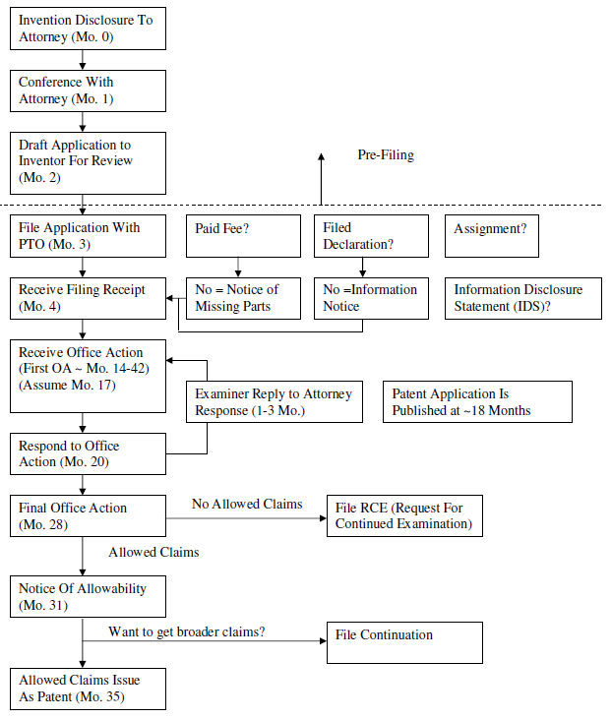
Provisional Application (up to 12 months before regular app)

Slide 15
Requirements For Patentability
Statutory Subject Matter - 35 U.S.C. § 101
Not just an idea! - Machine, manufacture, composition of matter, process tied to a machine or chemistry
No abstract algorithms or principles of science
Novelty - 35 U.S.C. § 102
No single Prior Art reference teaches all claim limitations
Prior art includes anything available to the public before your filing and any application filed before you
Non-Obviousness - 35 U.S.C. § 103
“Obvious” is a legal term – two or more prior art references when combined teach all claim limitations

Slide 16
Sample Applications
U.S. Pat. App. No. 2012/0238319 “System and Method For Combined Alarm Detection and Emergency Signaling”
U.S. Pat. App. No. 2012/0010844 “Sensors, Systems, and Methods For Measuring Fluid Perturbation”
IP Clinic drafted patent applications
Available at www.joebarich.com/ip-clinic.html

Slide 17
What does a business do with a patent?
Enforceable from date of issuance to 20 years from effective filing/priority date
Often the primary asset of a start-up company
Most of the value of the company is in their IP
Can boost corporate valuation
Bar competitors from your market
#1 Use - Preserve your market share
Sue infringers for money/injunction
Use as leverage for a joint venture or tech swap

Slide 18
Patent Basics
Trademark Basics
The IP Clinic
Patent Track
Trademark Track
Working With The IP Clinic

Slide 19
What Is A Trademark?
An identifier that identifies the origin of goods or services in commerce
Typically a word or logo - COUPLED with goods
Rights limited to those goods only
Trademark lasts as long as it is used
Can last forever
Two Types of Trademarks
Unregistered, common-law trademarks - TM
Federally registered trademarks – ®
Infringement Standard– Consumer confusion
If a consumer would think that goods from a second company actually originated from the company owning the trademark, then there may be infringement

Slide 20
Common Law TMs
Have some serious limitations
State law – not uniform nationwide
Limited to geographic area of use
Must prove consumer association
Must prove actual damages
No registration process, so you can’t be sure that a court will enforce your TM
Tough to enforce on internet sales

Slide 21
Registered Trademarks
Must register w/ the Patent and Trademark Office (PTO)
Provides registration so you can be reasonably sure of your mark’s enforceability before suing
Federal law, not state law
Can file Intent-To-Use application
Only mark that can use ®
Geographic exclusivity is the entire US
Can use the same mark in different fields of goods without confusion – must choose class for registration
Can still last forever if used
Can get statutory damages – like registered ©
No longer need to prove actual damages

Slide 22
Registering A Trademark
File TM application with PTO (attorney)
Word/Phrase or Logo Mark
One or more classes of goods – pay per class (45)
Application goes to Examiner
Examiner searches mark
Office Action if rejected – typically due to potential consumer confusion with other registered marks or descriptiveness
Otherwise, mark is allowed
Mark is published for opposition
Companies monitor new marks and file oppositions if they regard the new mark as too close to their own
If opposition, then lawsuit or abandon
Mark is registered on Principal Register
Mark can now be enforced

Slide 23
Common TM Misconceptions
Entrepreneurs erroneously think trademark consumer confusion is a straightforward text search
It’s not enough that your exact proposed mark is not in use, PTO can reject mark based on the legal principles of consumer confusion
Trademarks are NOT like a domain name registry. Even if you have the domain name, you may not be able to trademark it.
IP Clinic Law students provide insight into your odds of success and can research alternative marks
Trademarks can also be rejected for descriptiveness
Can’t trademark APPLE for apples or Java for coffee

Slide 24
What does a business do with a TM?
TMs are used to identify your goods/company
You want to create a strong and identifiable brand for the consumer – and then be able to defend your brand
Once you start marketing, you don’t want to have to change your name
Cumulative effect of advertising
Can enforce against counterfeiters
Block them from market
Seize and destroy their goods
Sue for statutory damages
Enforceable forever if continually used

Slide 25
Patent Basics
Trademark Basics
The IP Clinic
Patent Track
Trademark Track
Working With The IP Clinic

Slide 26
What is the IP Clinic?
TEC/College of Law Joint Effort – 16th year!
Spring semester only
Patent Track
You can get a Patent Application prepared for you!
But - Only if your company has an invention
Typically far more companies than law students
Trademark Track
You can get advice with regard to trademark strategy and a Trademark application prepared for you!
All companies use trademarks
Typically can provide TM work for nearly most companies

Slide 27
Who is the IP Clinic?
Law students in their 2L or 3L years – supervised by me
Background in Patent Prosecution or Trademark Law
Often have law firm experience or will be working at a law firm in a few months
Will be expected to prepare patent or trademark applications professionally in the summer or after graduation, typically without additional instruction
Law students independently pick the companies they will work with
IP Clinic prepares Patent/TM app and provides a filing presentation at the end of the semester
Companies must file their own applications and pay official fees
Likely $455 for patent and $250/$350 for TM, but filing not required

Slide 28
How to get in the IP Clinic
Participate in the Cozad New Venture Challenge!
Applications due late January to TEC
CNVC Teams apply for IP Clinic
2023 IP Clinic Startup Presentation – Jan/Feb 2023 date TBD
Sign up for TEC newsletter
Law students choose who to work with – companies that are more established are more attractive to work with
Prototype?, Website?, Business Plan?, Funding?,
For trademarks, a lawyer greatly increases your odds
Research study – 83% chance of success with lawyer, 46% greater than without a lawyer
Typically based on pre-filing research

Slide 29
IP Clinic Value Since Founding
Prepared 60 patent applications
Typical cost $10,000-$12,000
Total = $600K - $720K
Prepared 305+ trademark strategy and applications
Typical cost $2,000-$2,500
Total = $610K - $763K
Total value provided by IP Clinic = $1,210K-$1,483K
Approx. $1.3MM total or about $100K/year
This year – likely estimate–(enrollment not set)
3 patent applications ($30,000-$36,000)
40 TM applications ($80,000-$100,000)

Slide 30
Why Work With the IP Clinic?
Patent or Trademark Application = respect & value for your venture
Preference to serious entrepreneurs
Learn about patents and trademarks
Maybe get your own patent or TM
Seriously, how cool is that!
Business plan “Intellectual Property” section?
“Patent Pending” looks good on a resume
Not required to actually file the patent or trademark application, but we prefer to work with people who are more serious and will use what we prepare
See www.joebarich.com/ip-clinic.html for more info

Slide 31
Questions?
Thank You!
Joe Barich
Academic Website: JoeBarich.com
Professional Website: BarichIP.com
Barich IP Law Group
312-620-2471
joebarich@barichip.com

