Slide 1
Startups: Incorporation, Funding, Contracts, and Intellectual Property
Professor Barich
Class 11

Slide 2
Today
Review Exam #2
Class 11

Slide 3
Patent Summary
Legal right to exclude others from practicing your invention
  Make, use, sell, offer for sale, import
  Not a right for you to make, use, or sell
Function (How something works)
A sword, not a shield - does not “protect”, except as deterrent
In the Constitution itself – Art 1, Sec. 8, Clause 8

Slide 4
Where Do I Go To Get A Patent?
Patent and Trademark Office (PTO)
  Part of Department of Commerce
  Large government agency with thousands of employees.
Realty of the PTO –
  Huge bureaucracy
  Examiner Points and Quotas
  Unionized Employees
Sometimes called “The DMV on Steroids”

Slide 5
How Do I Get A Patent?
Draft patent application, submit to PTO
  Patent application is long, technical document
  Best to seek legal assistance
Patent application includes:
  Specification describing the invention
  Claims – very specific – the specific thing you have the right to exclude others from doing
  Only claims determine infringement
PTO rejects your claims and you negotiate, argue, and amend

Slide 6
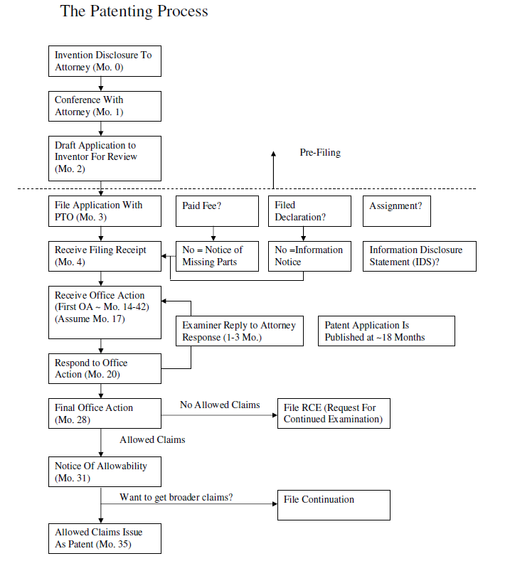
Patenting
Process
Provisional Patent Application
(up to 12 months before regular patent app)

Slide 7
Review of Patents
U.S. Pat. No. 7,753,421
  Sections of patents
  Spec can’t be changed once filed -claims can be
  Independent claims vs. dependent
U.S. Pat. App. Pub. US 2004/0221883
U.S. Pat. No. 7,017,598
U.S. Pat. No. 5,871,783
Allowance rates went from 72%->42%, now back up to about 65-70%.

Slide 8
Patent Application vs. Patent -1
Don’t confuse publication with an issued patent
  Claims can sometimes be alarmingly broad
  Claims in publication are typically claims at filing, and they are virtually always amended/narrowed before issuance
  Can only sue with an issued patent
  Can only collect damages starting at issuance (usually)
  Technically possible to collect pre-issuance damages, but only if claims at publication are substantially identical to claims at issuance, which is very rare

Slide 9
Patent Application vs. Patent -2
Powered Patio Pole Example
  Surgical amendment leads to issuance despite 23 rejections
  Claim is narrowed due to previously unknown prior art that is cited by Examiner during prosecution
  The most relevant prior art is typically unknown at the time of filing because prior patent applications are not published for 18 months
  Note: This is why your attorney needs to do a great job on the specification, so that there are additional elements that may be incorporated into the claim to avoid the prior art

Slide 10
Powered Patio Pole Example
Claim 1 at publication (App. No. 2004/0221883)
  1. A patio pole umbrella including:
  an umbrella canopy;
  a pole for supporting said umbrella canopy; and
  a power hub affixed to said pole, wherein said power hub includes an electrical outlet for supplying electricity to an electrical device.
Claim 1 in issued patent (Pat. No. 7,017,598)
  1. A patio pole umbrella including:
  an umbrella canopy;
  a pole for supporting said umbrella canopy; and
  a power hub affixed to said pole, wherein said power hub includes an electrical outlet for supplying AC electricity to an electrical device
  wherein said hub includes an input power receptacle receiving AC electricity.

Slide 11
Patent Statutory Requirements
Claims must satisfy 35 U.S.C. -
  §101 – Claim statutory subject matter – must fit within the statutory classes of patentable subject matter
  §102 – Be Novel - no one single piece of prior art teaches all of the limitations in your claim
  §103 – Be Non-obvious - seven PTO rationales based on prior art
  §112 – Be Clear – Written Description, Enablement, Best Mode

Slide 12
What is Prior Art?
In general, anything before your invention
America Invents Act
  Biggest change in 50 years
  Shift from first-to-invent to first-to-file
§102 prior art includes
  §102(a)(1) – Anything published, in use, or available to the public anywhere in the world before your filing
    Exception – your own disclosure if < 1 year before filing
  §102(a)(2) – Any patent application filed before your filing that is later published
  Prior Art as defined in §102 is applied/ used in both §102 and §103

Slide 13
Warning! - BAR DATES!
You can be prior art to yourself!
  U.S. has One Year Grace Period from date of first disclosure/commercialization
    File patent application within the year or lose rights forever
  Most Foreign Countries (EPO) = No Grace Period
    Disclose/ commercialize before filing and you blew it
  Foreign rights can be preserved by filing in the U.S. before disclosure and then later filing foreign app claiming priority to U.S.
  Disclosures in confidence (to attorney, under agreement of confidentiality), without commercialization, are typically OK
  See “Patent Do’s and D’oh!”

Slide 14
35 U.S.C §101
Whoever invents or discovers any new and useful process, machine, manufacture, or composition of matter, or any new and useful improvement thereof, may obtain a patent therefor, subject to the conditions and requirements of this title.
Often erroneously called “utility” requirement
  PTO does not examine for utility
4 statutory classes – claims must be in one
  Claim requirement, not invention requirement
  No more “signal” claims

Slide 15
§101 Claim Requirements
General Rule: Can’t claim an abstract principle
In re Bilski – 2010 Supreme Court decision
  A process claim is patentable subject matter if it (1) is tied to a particular machine or apparatus or (2) transforms article into a different state or thing
  Bilski merely claimed “initiating a transaction” = no good
Alice Corp. v. CLS Bank International – 2014 SC
  Merely implementing an abstract idea on a computer does not make it patentable subject matter
  Computer system for performing 3rd party escrow (well known) and did not provide any computer specifications or code
  Need additional substantive limitations that narrow, confine, or otherwise tie down the claim so that, in practical terms, it does not cover the full abstract idea itself.
Often a claim issue rather than an invention issue
  If claim is too abstract, additional functional components of the invention may be recited in the claim to make it less abstract

Slide 16
35 U.S.C 102
§102 – Be Novel - no one single piece of prior art teaches all of the limitations in your claim
  Prior art can be from anywhere in the world
  Ex. - Publication in Japanese only
  Ex. - Conference paper from Russia
  Ex. - On sale only in Australia
However, the PA must teach all limitations
  Note: If single piece of PA only teaches 4 of 5 limitations, it is not a valid §102 rejection, but it may be combinable with another piece of PA to form a rejection under § 103

Slide 17
35 U.S.C. 103
2007 KSR decision expands obviousness
  Old test - Teaching, Suggestion, or Motivation to Combine references (TSM)
  New test – No clear test, just “factors”
  PTO resolves factors into seven “rationales” supporting an obviousness rejection
  Huge expansion of the scope of obviousness
Impact
  Substantial difficulty in getting around 103 rejections
  Increased cost and time
  Reduction in claim scope

Slide 18
PTO Obviousness Rationales
(A) Combining prior art elements according to known methods to yield predictable results;
(B) Simple substitution of one known element for another to obtain predictable results;
(C) Use of known technique to improve similar devices (methods, or products) in the same way;
(D) Applying a known technique to a known device (method, or product) ready for improvement to yield predictable results;
(E) ‘‘Obvious to try’’—choosing from a finite number of identified, predictable solutions, with a reasonable expectation of success;
(F) Known work in one field of endeavor may prompt variations of it for use in either the same field or a different one based on design incentives or other market forces if the variations would have been predictable to one of ordinary skill in the art;
(G) TSM Test

Slide 19
35 U.S.C. 112
A written description sufficient to enable one of ordinary skill in the art to practice the invention without undue experimentation and showing the inventor’s best mode.
  Written Description – invention “Possession”
  Enablement – Do you teach others?
  Best Mode – No hiding the ball
    Removed as a requirement under AIA
  Ex – Claim a space ship with an ion drive
    Written description but not enabled
  Ex – Claim a known cancer formula for the new use of growing hair
    Enabled but no written description

Slide 20
Claims - 1
The style of legal protection that you are requesting for your invention
Structural-Functional claim continuum
Many types of claims
  Apparatus – (common) Primarily structural
    Best use in simple mechanical claims
    Need not explicitly say “apparatus”
    “A baseball glove including:” is apparatus claim
    Example: ‘421 patent claim 1
  System (common) Mostly structure
    Effective for use in claiming devices that have a function or are more complicated. For example, devices with software elements. Software doesn’t seem to fit as an apparatus.

Slide 21
Claims - 2
  Method/Process (common) functional
    Everything except composition of matter can be claimed functionally as well as structurally
    Each claim element is “X-ing”
  Means Plus Function (uncommon)
    Example - “a means for fastening”
    Claim scope is limited solely to embodiments taught in specification and courts view narrowly
  Product By Process (certain areas only)
    Claims structure produced by process
    Can be effective in chemistry or claiming new mixtures

Slide 22
Claims - 3
Typically claim each “invention” using multiple claim types
  Typically method (function) + structural
  Each claim type has different strengths and weaknesses
  Must be performed entirely within US?
    Method = yes, System = no
  Method claims are generally thought to be broader
  System claims may be harder to invalidate
  Must mark product if system claims, but not method

Slide 23
Infringing A Claim
In order to infringe a claim of a patent, the accused product MUST do absolutely everything recited in the claim
  Remember – claim is allowable if even one element of claim is absent from prior art, so all elements must be present in alleged infringing product
Only a single claim of a patent needs to be infringed for full damages
  Damages do not double if multiple claims infringed
Dependent claims are fallback positions
  If new prior art comes up at trial and invalidates independent claim, dependent claim may still be valid and infringed

Slide 24
Infringing A Claim - 2
In general, the shorter the claim (fewer elements), the broader the claim
  Broader claim may be more valuable because it locks away a larger scope
  May be more vulnerable to invalidity attack
File Continuations - Think 1:N rather than 1:1
  Often have several issued continuations with claims of different scopes
  Later continuations often have broader claims
  Can keep continuation pending to introduce new claims directed to competitor’s embodiment –BUT! the claims must be supported by original specification

Slide 25
Evaluating Patent Strength - 1
U.S. Pat No. 5,871,783 - Apparatus For Ultrasonically Forming Confectionary Products

Slide 27
Evaluating Patent Strength - 2
U.S. Pat No. 5,871,783 - Apparatus For Ultrasonically Forming Confectionary Products
Description Claiming vs. Point of Novelty Claiming
Claim 1 of U.S. Pat No. 5,871,783
  Description claim
  Lots of unnecessary claim limitations
  Remember: ALL claim limitations must be found in alleged infringing embodiment for there to be infringement
  Avoid infringement by not having one thing in the claim

Slide 28
Evaluating Patent Strength - 3
What to do? File Continuation!
  Same specification, but better claiming
Claim 11 of U.S. Pat. No. 6,210,728
  Point-of-Novelty Claim (in continuation)
  11. A method of forming confectionery products, said method comprising:
  ultrasonically energizing a forming tool having a forming cavity; and
  forming supplied confectionery stock into a confectionery product by engaging said confectionery stock into said forming cavity of said forming tool.
  Successfully licensed for large $
  Bottom Line: Value of the patent is in the claims and can vary

Slide 29
Novelty vs. Infringement - 1
Novelty Analysis = PTO’s examination process
  Comparing your claims to prior art (patent specifications and products)
  PTO only looks at novelty, not infringement
    This is why getting a patent is no guarantee that you are not infringing another patent
  Validity/Invalidity Analysis = Doing a novelty analysis on an issued patent attempting to show at trial that the patent should not have been issued by PTO
Infringement/non-infringement Analysis
  Comparing your claims to a product
  Novelty and Infringement analyses are very different

Slide 30
Novelty vs. Infringement -2
Novelty vs. Infringement example
  If claim recites ABCDE and prior art only shows ABCD, then claim is NOVEL because there is one limitation not taught by the prior art – it is NEW!
  However, there may be an earlier patent that claims ABCD so if the ABCDE product is made, it would still infringe the earlier patent
Conversely, all of the limitations of the claim must be found in the alleged infringing product for infringement to occur
  If claim is ABCDE, products ABC, ABCE, and ABCDG do not infringe
  However, product ABCDEF would infringe because it includes all of ABCDE plus something else

Slide 31
Litigating a Patent -1
When sued, fight back using both invalidity and non-infringement arguments
  You win by establishing either (a) their patent is invalid, or (b) your product does not infringe their claims
  Plaintiff must prove infringement by preponderance
  Defendant must prove invalidity by the clear-and-convincing standard (affirmative defense)
    Gives some deference to PTO decision
When suing, must prove infringement and defeat invalidity affirmative defense

Slide 32
Litigating a Patent -2
Patents can be invalidated at trial
  The opposing counsel typically finds new prior art not considered by the Examiner
    The Examiner only spends $1720 worth of time to find prior art, but the company being sued may spend millions
  The new art may be used to “second guess” the PTO and invalidate patent – Ex. –it may lack novelty or be obvious
  Thus, it is better to have cited as many references as possible to the PTO during examination – use IDS
Willful infringement can treble damages
    Defeat with Opinion of Counsel

Slide 33
Patent Term
Filing =“Patent Pending”
  Can’t sue yet - Even less of a right than “TM”
  Filing a patent application with the PTO is said to be “prosecuting a patent” and the process is often called “patent prosecution.”
  No rights to enforce patent until issuance
Term of patent is 20 years from its date of priority (typically its date of filing)
  But! takes 3-5 years to issue as a patent right thus providing an enforceable term of approximately 15-17 years.

Slide 34
Provisional Patent Application
Quick and informal filing with PTO
  Gives you a priority date (for subject matter disclosed)
    Must still be an enabling disclosure of the invention, but can be computer code, manuals, lab books, presentations, etc.
  Good for avoiding a bar date
  Cheaper (as low as $1.5K-$3K vs. $8-12K)
  Only lasts for one year –
    Must then file a regular utility patent application or the provisional application is abandoned
    Not a patent, just an application – can’t sue using it
Often filed as “option” by inventor, then shop around and file utility application if funded
  One provisional can become many utility patent applications and vice versa

Slide 35
Design Patents
What you know as a patent is technically a “utility patent”
Design Patent – directed to ornamental appearance of industrial article
  How the product “looks,” not how it “works”
  Can still be a functional article, but coverage is directed to the ornamental appearance
  Ex - Lamp with base in shape of a statute

Slide 36
Design Patent Basics - 1
First design patent issued in 1842 for a font
Copyright did not cover functional or industrial articles at the time, therefore new form of IP was desired
As of January 1, 2019 -
  837,479 issued US design patents
  10,172,270 issued US utility patents

Slide 37
Design Patent Basics - 2
Design Patents differ from copyrights
  Design Patents have a different standard for grant and a different infringement standard from copyrights
  Design patents must be novel and non-obvious
  Design patents last for 15 years from issuance and have a presumption of validity
    Term is 14 years from issuance if filed before May 13, 2015
  In a nutshell, design patents have a shorter term, but are a “tougher” IP right

Slide 38
Design Patent Basics - 3
Claim language is standard
Claim scope is what is shown in solid lines, dotted lines are just for context
See Sample Design Patents
  U.S. Des. 595,574
  U.S. Des. 599,372

Slide 39
Design Patents Are Increasing
Dramatic increase in issued Design Patents per year
  USPTO 1998 ~ 11,000
  USPTO 2018 = 29,441
Strong enforcement options
  Can even seek exclusion order at the International Trade Commission (ITC)
Can mesh with other IP including trade dress

Slide 40
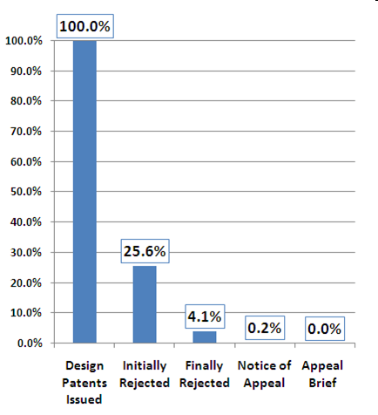
Most DP Apps are Issued
For Issued DPs
About 75% issued without a rejection
About 96% issued without a final rejection
Note: Finally rejected apps may represent 20% - not on chart
Graph courtesy of Dennis Crouch @Patentlyo.com

Slide 41
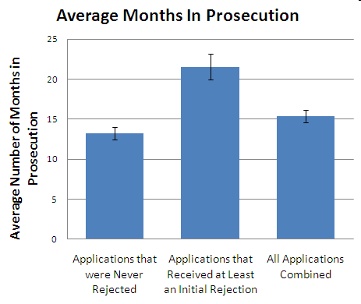
DPs Issue Fairly Quickly
On average 14 months to issuance if no rejection
On average 23 months to issuance if rejected
Graph courtesy of Dennis Crouch @Patentlyo.com

Slide 42
DPs Becoming More Important - 1
Clients are increasingly turning to DPs
Most filed Design Patents get through PTO
Design Patents get through quickly, so can be used as a preliminary strategy
Stronger IP right than copyright
Case law makes infringement of design patent easier to establish
  Egyptian Goddess v. Swisa, Fed. Cir. 2008 (en banc)
  “Ordinary Observer” Test is the sole test for infringement
  “[I]n the eye of an ordinary observer, giving such attention as a purchaser usually gives, two designs are substantially the same, if the resemblance is such as to deceive such an observer, inducing him to purchase one supposing it to be the other”

Slide 43
DPs Becoming More Important-2
Apple Inc. v. Samsung Electronics Co., Ltd. (1st)
Aug. 24, 2012 - Jury verdict for $1.049 Billion
Involved both utility patents and design patents
  D504,889
  D593,087
  D618,677
  D604,305
All except ‘889 were found to be infringed by at least some Samsung devices
Judgment later reduced to around $930M
  Settled for $548M w/clawback if patents invalidated
  SC changed $400M design patent damage calculation and remanded in Dec 2016 – no invalidation
  May 2018 - New trial - $539M for Apple
  June 2018-Apple and Samsung finally settle – terms confidential

Slide 44
Questions?

