Slide 1
Startups: Incorporation, Funding, Contracts, and Intellectual Property
Professor Barich
Class 5

Slide 2
Reminders
Class 5 Lecture
Exam #1 – second half of class
Review Exam #1 Next week
Peer Scores

Slide 3
Venture Investment Data
Top US cities for venture capital investing in 2014-2020
  2014 2017 2020
  SF Region* $24.8B $33.5B $20.1B
  NY $5.3B $12.3B $7.1B
  Boston (+ Cambridge) $4.1B $8.7B $8.2B
  LA (+Irvine) $2.3B $6.5B $4.4B
  San Diego -- -- $3.2B
  Seattle $1.2B $1.7B $1.9B
  Chicago $862M $1.8B $820M
  Chicago % of SF = ~3.5% (2014), ~5.4% (2017), ~4.1% (2020)
*Also includes “Silicon Valley” of San Jose, Palo Alto, Redwood City, and Mountain View

Slide 4
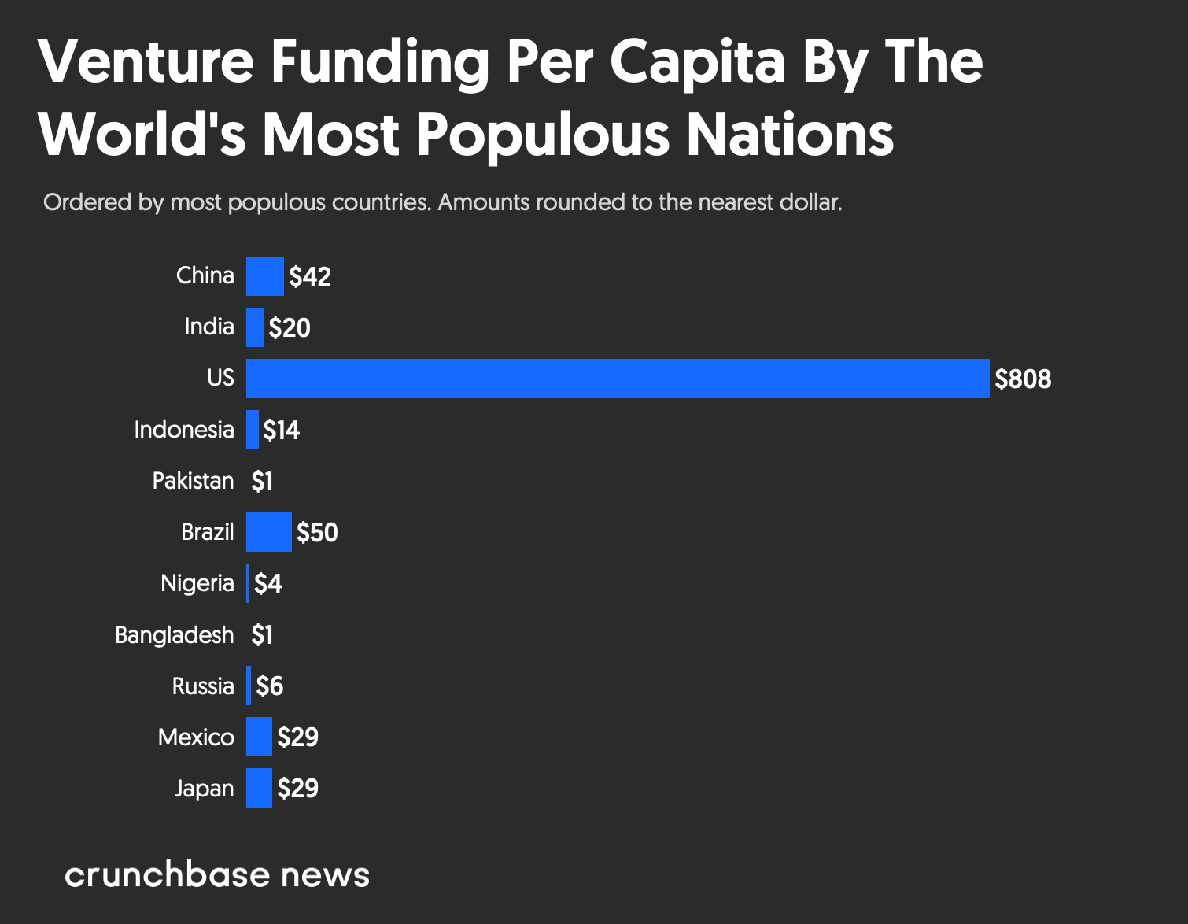

Slide 5
Part 2 - Contracts
Entrepreneurs must deal extensively with contracts
  Give a legally enforceable right
  But! Contracts may be a legal tool, but their greatest business strength is their use to get something done, not their use as an exhibit in a courtroom
  In a general sense, contracts really establish and structure/define relationships
    Can be a simple or complex relationships
    We really just want to have clear terms for our relationships and avoid disputes so that our company can grow

Slide 6
What is a contract?
What is a legally binding contract?
  (1) An agreement, (2) Between at least two parties, (3) That is actually enforced by a court
Not all agreements are enforceable
  You never know for sure until the court rules
  Many people think that they have a legally binding contract/agreement when they really just have an unenforceable agreement
But! If you believe a contract binds you - it does
  Elephant Metaphor

Slide 7
Necessary For A Contract? - 1
What is necessary to have an agreement that a court will enforce?
  Does it need to say “Contract” at the top?
  No - It’s just an agreement, typically don’t have to use “magic language”
  Does it need to be written on paper?
  No - Electronic transmission and storage is often considered more permanent than paper

Slide 8
Necessary For A Contract? - 2
What is necessary to have an agreement that a court will enforce?
  What if one person is just kind of joking around?
  Maybe - Objective reasonableness created in the mind of the perceiver?
  What if I just write someone an e-mail that says “unless you tell me different by Oct 1, then X”?
  Maybe - Objective reasonableness based on custom, practice, communications, etc.

Slide 9
Contract Interpretation - 1
Much of contract law is based on “reasonableness” – we want to enforce what the parties reasonably agreed to
  Honor expectations of the parties
  Honor practice in industry
Typically, this is objective reasonableness, not subjective
  What a reasonable observer would think, not what you thought you were doing
  May vary based on environment

Slide 10
Contract Interpretation - 2
Lack of clarity in a contract is typically construed against the drafter
Contracts try to cover all eventualities, but rarely do
  Terms not specifically called out in a contract, yet seemingly required are interpreted using reasonableness
We want to be as clear as possible in our contracts
  Terms like “within a reasonable time” are not typically very clear

Slide 11
Contract Interpretation - 3
Contracts for ongoing relationships are often modified or depart from the original terms
  Situations change
  “Living Document” of an agreement reflecting the current understanding of the relationship
Just having a contract with certain parties may be of great benefit to you
  Signing a contract with Google may be a valuation/reputation/appearance of stability boost

Slide 12
Enforcement - 1
Contract disputes often arise due to lack of clarity in the contract
  The parties often had different expectations when entering the contract and focused on “getting the contract signed” rather than creating a clear working relationship
  Making your contracts clear and addressing issues pro-actively through the negotiation process is best
  Focus on establishing the relationship, the contract is a clarification tool to make sure that everyone is on the exact same page

Slide 13
Enforcement - 2
Complex contracts are rarely “iron-clad”
Typically allow the parties to withdraw
  Not going to lock yourself up forever
  Need to be able to adapt to changes
Often lack of clarity in terms arises
  Even if the terms were clear at the time of signing, circumstances may change that render them unclear
  Tech advances - “Full-bandwidth connection”
  Legal/Factual changes – “1st national bank of Yugoslavia”
  “10% of profit”

Slide 14
Enforcement - 3
Contracts are enforced through the courts
  Expensive, time consuming, uncertain
  All potentially lethal for a startup
Other party may attempt to weasel out due to business changes or seeking greater profitability
  Personal honor matters
  Even if they breach, it may be to your business benefit to just ignore it and move to someone else
  Looking for relationships to help growth, not obsessive enforcement

Slide 15
Enforcement - 4
Think before entering agreement
  If you think that the only way you will get the other party to perform their end of the contract is the court system, find someone else
  You want to grow fast and a contract dispute will be a drag on growth
  Don’t make contracts with the Devil thinking that the contract will save you
  Remember! If a dispute arises, you are first going to approach the other side to make it right before you go to the court system – if they are reasonable it can be worked out
  Only going to court when it completely breaks down

Slide 16
Enforcement - 5
Even if you “win” a case, it doesn’t mean that you are getting your money (at least not right away)
  Must bring action against specific assets and they might not have much in assets
  They might appeal (delays enforcement)
    Appeals court might Reverse - back to zero
    Appeals court might Remand – more time and delay
  They might enter Bankruptcy protection
    More on next slide
    Rare to get nothing, but could only get a small fraction
  Other side may offer to settle after adverse judgment for amount less then judgment – you might prefer money “in-hand” today
    Corollary: $100 million judgment against a bankrupt entity with zero assets is worthless – there is nothing to collect

Slide 17
Bankruptcy - Lots of misunderstanding
    Bankruptcy is a Debtor’s request to a court to be relieved of debts
    Does NOT mean the Debtor (person or company) is broke (has zero assets)!
    Court can discharge or adjust debts/judgements/contracts
    Separate unit of the Federal District Court. Only hears Bankruptcy cases. All Bankruptcies are federal cases!
    Corporate - emphasis on preserving business to preserve jobs.
    Personal – emphasis on reasonable repayment
    Chapter 7 – Liquidation of assets (individual-discharge of debts or corporate dissolution of company) - assets go to debtors and the rest is forgiven
    Chapter 11 – Corporate-reorganization + discharge of debts
    Chapter 13 – Individual-payment plan (typically 7 years) + discharge of remaining debts after completion of payment plan

Slide 18
Get It In Writing - 1
Sometimes people feel that getting something in writing indicates that you don’t trust the other person – no!
What it really helps with is clarity:
  Tough to get really specific on the terms of the agreement in an oral exchange. Lots of opportunity for misunderstanding/lack of specificity
  Separates “just talk” from “OK, this is really serious”
And preventing “drift”
  Recollections change over time
  Situation may change – e.g., new person in company
  Expectations change
  Lack of clarity and drift are real factors that experienced entrepreneurs know are likely to arise and they want to minimize/address up front

Slide 19
Get It In Writing - 2
Of course, it does really help with enforcement, but you really don’t want to have to go there
  Focusing on establishing a clear relationship so that you can work together successfully
  But! Some agreements MUST be in writing to be enforceable
“Writing” means any non-transitory memorialization
  E-mail, Text, etc.
Prefer modalities that are self-authenticating
  E-mail is trackable, no need to ask if they recognize their signature on the contract

Slide 20
Origins of Contract Law
Where does contract law come from?
  Historic Case Law
  Restatement of Contracts (“Restatement”)
  Uniform Commercial Code (“UCC”)

Slide 21
Contract Law- 1
Historically, contract law was developed by the states in the state court system of each state as opposed to the federal court system
  Lots of regional variation in interpretation of claims and provisions
  Meaning of “Reasonably Promptly” that was enforced by a particular state court could vary
    Maybe - Within 1 day in Massachusetts
    Maybe - Within 30 days in Alabama
  Interpretation arose from what local community found to be reasonable and repeatedly enforced

Slide 22
Contract Law - 2
General practice over decades created a fairly uniform sample set of decisions so that you could generally predict what a court would enforce
  This is called “Case law”
Sometimes state legislatures would intervene and codify contract principles
End up with fairly specific, but fairly local:
  Interpretation of terms
  Some agreements/clauses not enforceable
  Requirements for binding agreement

Slide 23
Evolution of Contract Law - 1
Locally varying contract law works well with local contracts
  Example - Two Vermont Farmers – OK!
    Both are socialized to have the same local community values
    Both had the same expectation of those internalized values when they entered agreement
But! - Now we have trains and roads and people of different communities making agreements
  Example - New Yorker and Texan – Uh-oh
    Very different values
    Very different local laws and local case law
    Very different expectations when entering the agreement

Slide 24
Evolution of Contract Law - 2
So which state’s law gets used to interpret and enforce the contract?
A race to the courthouse! -
  Under the Constitution, states must give “full faith and credit” to court decisions by another state
  Judgment from New York court must be enforced by Texas court
State courts arguing about jurisdiction – especially elected judges, as many state judges are
State legislatures expanding state jurisdiction to allow all possible cases to be filed there so that the state court can look after their citizens
  “Long-arm” statutes allow suit in a state if you have minimum contacts with the state

Slide 25
Evolution of Contract Law - 3
More recent unifying factors
  Widely published national models for contracts
    Restatement of Contracts
    Uniform Commercial Code (UCC)
  Choice of Law provisions in contracts
  In general, the people with the money write the contracts and set the rules
    Investors get what they want -and they use their local rules
  Much, much, greater societal uniformity over different geographies with the advent of mass media – people nationwide trained to accept uniform standard
Today – still some state variations, but substantial degree of uniformity on basics

Slide 26
Restatement - 1
Restatement (Second) of the Law of Contracts started in 1962, finished 1979
Lawyers from many states got together to create a treatise with regard to how to interpret contracts
  Tried to agree on what was “reasonable” nationwide
  Non-binding, but very persuasive and implemented by many states
  Sometimes only partially implemented by state legislatures or modified to reflect local case law

Slide 27
Restatement - 2
Restatement is high-level, definitional law – Exs.
§24. OFFER DEFINED - An offer is the manifestation of willingness to enter into a bargain, so made as to justify another person in understanding that his assent to that bargain is invited and will conclude it
§30. FORM OF ACCEPTANCE INVITED
(1) An offer may invite or require acceptance to be made by an affirmative answer in words, or by performing or refraining from performing a specified act, or may empower the offeree to make a selection of terms in his acceptance.
(2) Unless otherwise indicated by the language or the circumstances, an offer invites acceptance in any manner and by any medium reasonable in the circumstances.

Slide 28
Restatement vs. UCC
Criticism - Restatement is too high-level, covers too many sensitive areas
  Maybe we only need to support uniform system for sale of goods across state borders – not real estate or services, which states disagree about more extensively
  Need specific enforcement of standard business terms
  Need actual terms to be adopted as law by the states
Enter UCC – Uniform Commercial Code
  Deals with “personal property” (goods) rather than real estate or services – for those look to Restatement
  Codified in all 50 states, so very uniform across the states – Restatement is much less uniform

Slide 29
UCC – Really Technical
Article 2, § 2-310. Open Time for Payment or Running of Credit; Authority to Ship Under Reservation.
Unless otherwise agreed
(a) payment is due at the time and place at which the buyer is to receive the goods even though the place of shipment is the place of delivery;
(b) if the seller is required or authorized to send the goods, the seller may ship them under reservation, and may tender the documents of title, but the buyer may inspect the goods after their arrival before payment is due unless the inspection is inconsistent with the terms of the contract (Section 2-513);
(c) if tender of delivery is agreed to be made by way of documents of title otherwise than by paragraph (b), then payment is due regardless of where the goods are to be received (i) at the time and place at which the buyer is to receive delivery of the tangible documents, or (ii) at the time the buyer is to receive delivery of the electronic documents and at the seller's place of business or if none, the seller's residence; and
(d) if the seller is required or authorized to ship the goods on credit the credit period runs from the time of shipment but postdating the invoice or delaying its dispatch will correspondingly delay the starting of the credit period.

Slide 30
UCC- 2
Pretty much any “good” that you have ever purchased has been governed by the UCC
  Any personal, portable thing
  Eggs to clothes to iPads
If your company is going to be selling goods, the sale will be governed by the UCC
Have you ever read those “fine-print” forms? Their content is based on the UCC

Slide 31
Restatement vs. UCC
Some cases would be decided differently based on whether the Restatement or UCC is used to interpret the law
How do I know which one is going to be used to interpret my contract?
  Quick and Dirty – Are you a merchant selling goods? If yes, then UCC. Otherwise Restatement, especially if real estate or personal services are involved

Slide 32
State or Federal Court? - 1
Only get to Federal Court if the Federal Court has “jurisdiction”
  Whether the Court is authorized to hear your dispute
Two primary kinds for Federal Court
  Federal Question Jurisdiction – a lawsuit with regard to federal laws or treaties (patents, contract with govt., etc.)
  Diversity Jurisdiction – between “citizens” of different states and amount exceeds $75,000
    Corporation is a citizen of state of incorporation and state of principal place of business
  Supplemental Jurisdiction in some cases

Slide 33
State or Federal Court? - 2
If no Federal jurisdiction, you are in state court
Contract cases are typically not a Federal Question, but diversity jurisdiction may exist
Thus, majority of contract cases heard in state court
Many people want to be in Federal court
  Judges are appointed, not elected
  Belief that judges know the law better
  State courts may employ “home cooking”
  Perception of more fair procedure
  If the company has strong ties with the state, they may want the state court

Slide 34
State or Federal Court? - 3
Even if the case is heard in federal court, the contract is still interpreted using the law of one of the states
  “Choice of law” provision in contracts
  “This Agreement shall be governed by the laws of the State of Illinois.”
  The choice of law may produce a different outcome depending on which state’s law is used

Slide 35
  Questions?
  See you next week!

